Slide 1
11.5 Efficient Cross-Validation via Boosting

Slide 2
The big picture

Slide 3
The basic principle behind boosting based cross-validation is to progressively build a high capacity model one unit at-a-time, using units from a single type of universal approximator.

Slide 4
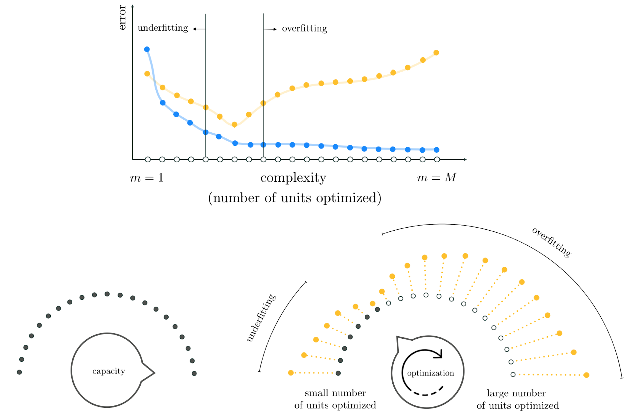
(top panel)Prototypical training and validation error curves associated with a completed run of boosting.(bottom panels) We fix the capacity dial all the way to the right and the optimization dial all the way to the left, slowly turning it from left to right, with each notch denoting the complete optimization of one additional unit of the model.

Slide 5
Whether we use fixed-shape, neural network, or tree-based units with boosting we will naturally prefer units with *low capacity* so that the resolution of our model search is as fine-grained as possible.

Slide 6
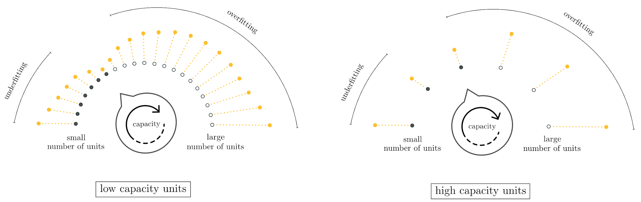
(left panel) Using low-capacity units makes the boosting procedure a high (or fine) resolution search for optimal model complexity.(right panel) Using high-capacity units makes boosting a low (or coarse) resolution search for optimal model complexity

Slide 7
Technical details

Slide 8
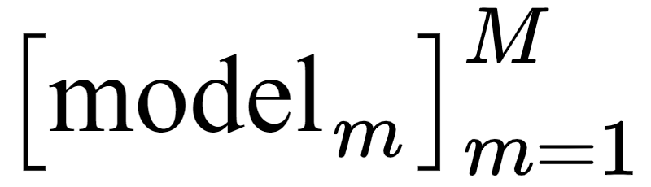
For boosting we need a set of M nonlinear features or units from a single family of universal approximators
We add these units sequentially or one-at-a-time building a set of M tuned models that increase in complexity with respect to the training data, from m=1 to m=M, ending with a generic nonlinear model composed of M units.

Slide 9
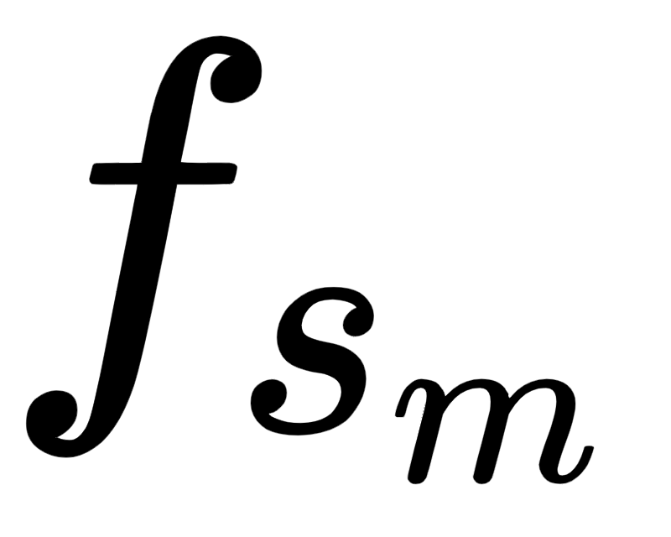


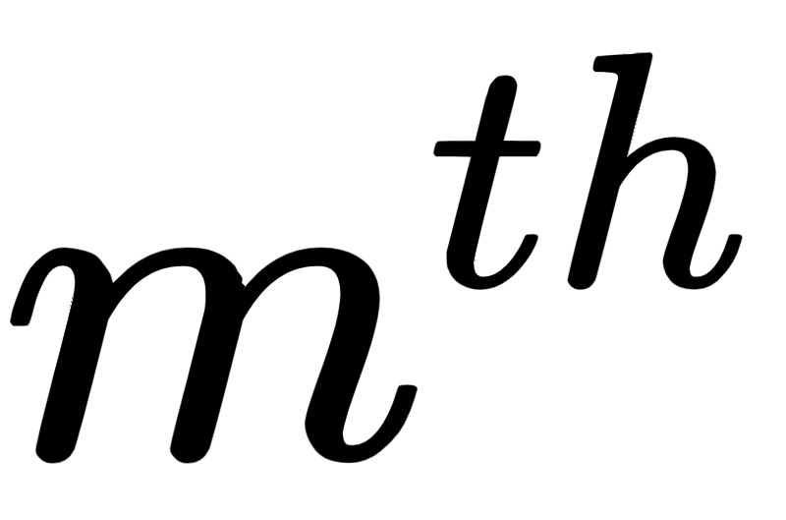


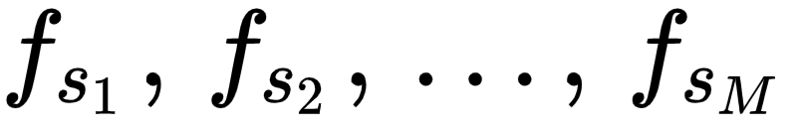

We will express this final boosting-made model as
Here we have re-indexed the individual units to (and the corresponding weight ) to denote the unit from the entire collection in added at the round of the boosting process. The linear combination weights through along with any additional
weights internal to are
represented collectively in the weight set .

Slide 10
The process of boosting is performed in a total of M rounds.
At each round we determine which unit, when added to the running model, best lowers its training error.
We then measure the corresponding validation error provided by this update, and in the end after all rounds of boosting are complete, use the lowest validation error measurement found to decide which round provided the best overall model.

Slide 11
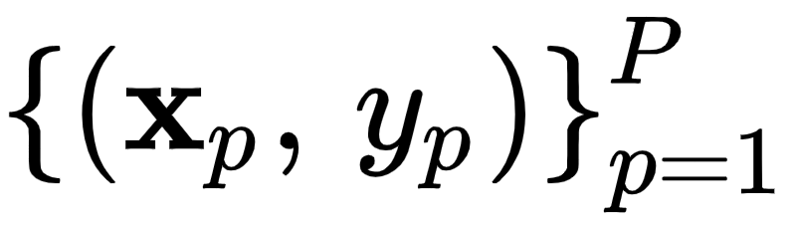
For the sake of simplicity, we only discuss nonlinear regression on the training dataset employing the Least Squares cost.
However, the principles of boosting we will see remain *exactly* the same for other learning tasks (e.g., two-class and multi-class classification) and their associated costs.

Slide 12
Round 0 of boosting

Slide 13
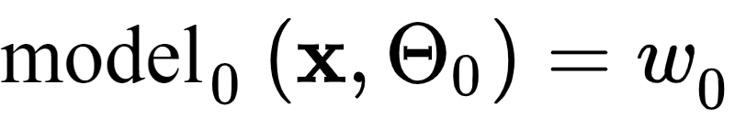
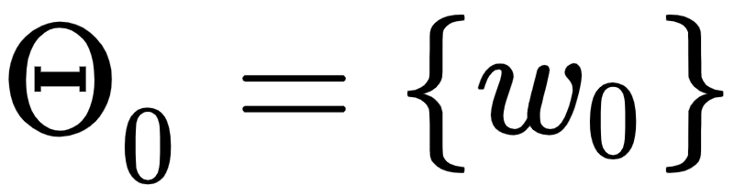

Round 0 starts with the model
whose weight set contains a
single bias weight, whose optimal value is found by by minimizing the Least Squares cost
We fix the bias weight at the value of forever more throughout the process.

Slide 14
Round 1 of boosting

Slide 15

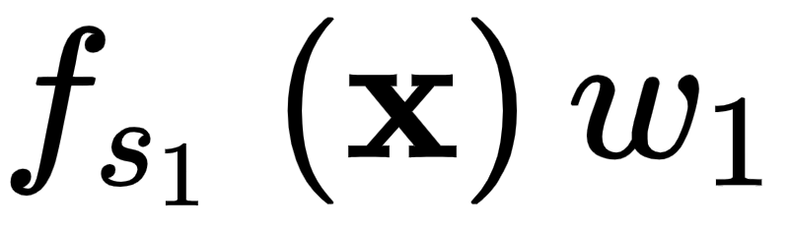


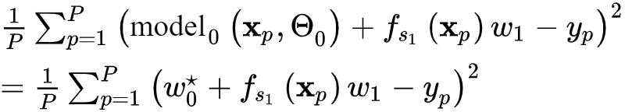
Having tuned the only parameter of we now *boost* its complexity by adding the weighted unit to it:
To determine which unit in our set best lowers the training error, we press against the data by minimizing the following cost for every unit

Slide 16
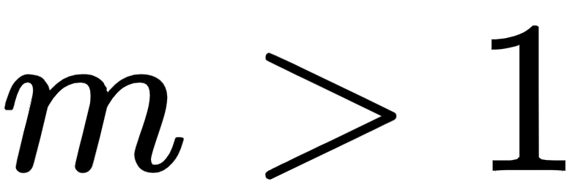
Round of boosting

Slide 17
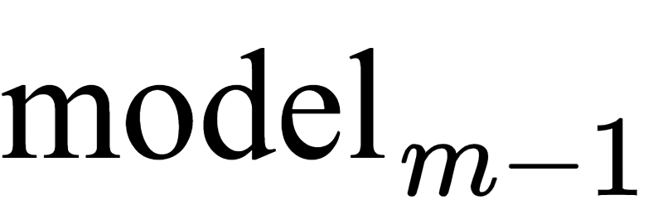
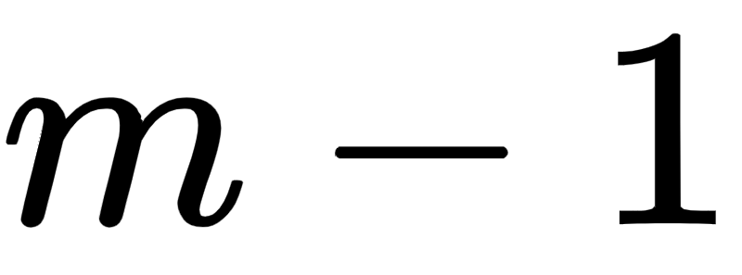
We begin with consisting of a bias term and units of the form

Slide 18
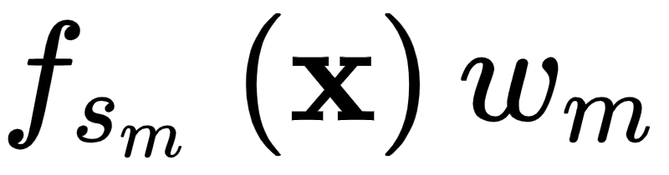

We then seek out the best weighted unit to add to our running model
by minimizing the following cost

Slide 19
Note again the form of the following cost function which we have to minimize over and :
If we use fixed-shape or tree-based approximators, this entails solving M (or M-m+1, if we decide to check only those units not used in previous rounds) such optimization problems and choosing the one with smallest training error.
If we use neural networks, since each unit takes the same form, we need only solve one such optimization problem.

Slide 20
Early stopping

Slide 21
Once boosting is complete we select from our set of models the one that provides the lowest validation error.
Alternatively, instead of running all rounds of boosting and deciding on an optimal model after the fact, we can attempt to *halt* the procedure when the validation error first starts to increase.
This concept, referred to as *early stopping*, leads to a more computationally efficient implementation of boosting.
However, one needs to be careful in deciding when the validation error has really reached its minimum as it can oscillate up and down multiple times.

Slide 22
An inexpensive but effective enhancement

Slide 23
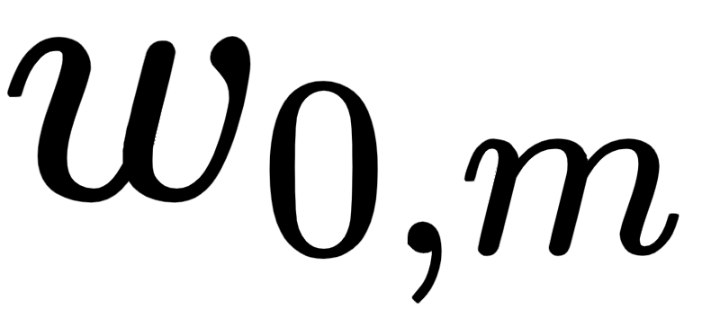
At the round of boosting we can add an additional bias weight as
This simple adjustment results in greater flexibility and generally better overall performance by allowing units to be adjusted 'vertically' at each round.

Slide 24
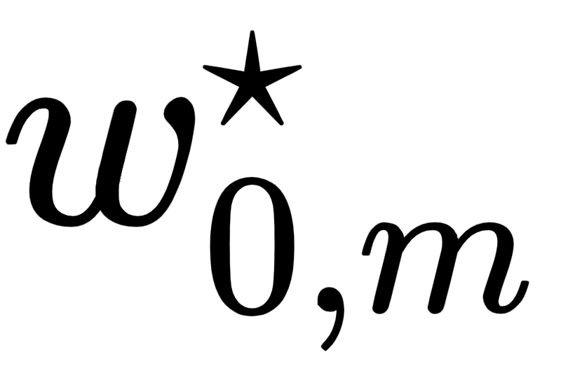
Note that once tuning is done, the optimal bias weight can be absorbed into the bias weights from previous rounds.
This enhancement is particularly useful when using fixed-shape or neural network units for boosting, and is redundant when using tree-based approximators.

Slide 25
Example: Boosting regression using stump units

Slide 26


In the following animation we illustrate the result of M = 100 rounds of boosting using a set of B = 20 stumps (many of the stumps are used multiple times) on a toy regression dataset.
Data is split into training (blue) and validation (yellow).

Slide 27
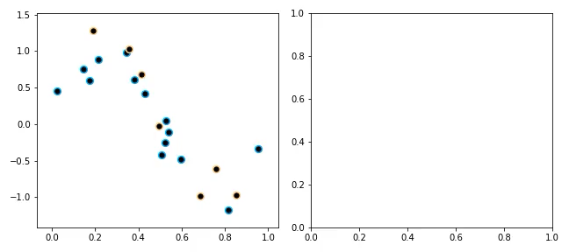

Slide 28
The residual perspective with regression

Slide 29
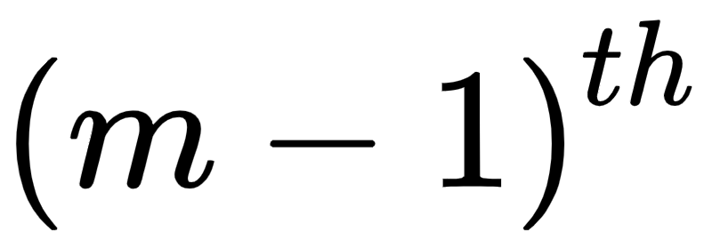
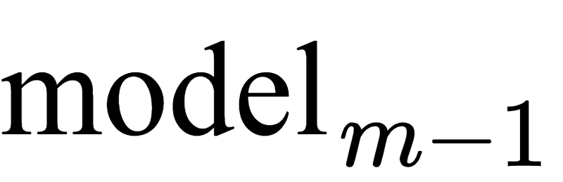
Consider the following Least Squares cost function where we have inserted a boosted model at the round of its development
We can write our boosted model recursively as
where all of the parameters of the model (i.e., ) are already tuned.

Slide 30
Combining the equations of the previous page we can re-write the Least Squares cost as
By minimizing this cost we look to tune the parameters of a single additional unit so that for all p we have
The RHS is the difference between our original output and the contribution of the model, is often called the *residual*: it is what is left to represent after subtracting off what was learned by the model.

Slide 31
Boosting regression and the 'fitting to the residual' perspective

Slide 32

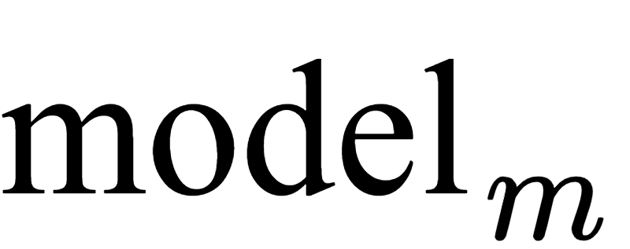
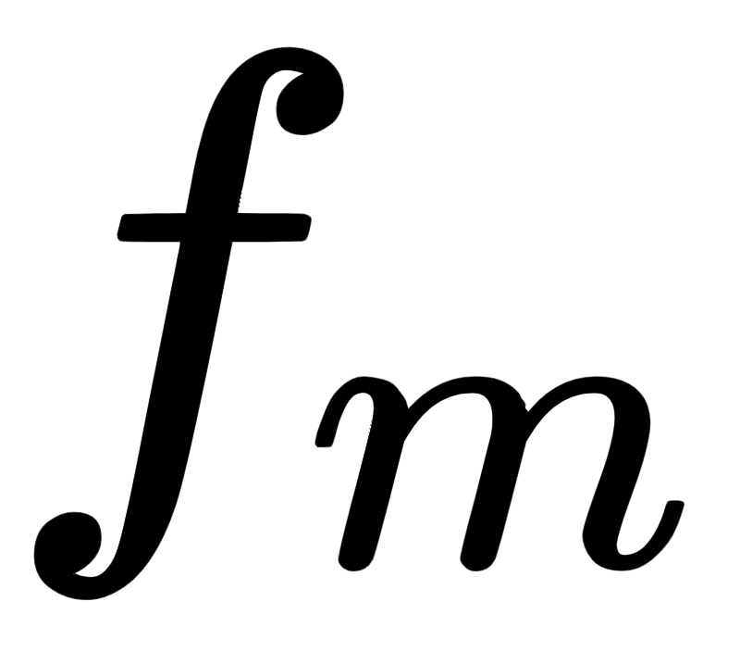
In the animation below we illustrate the process of boosting M = 5000 single-layer units to a toy regression dataset.
left panel shows the dataset along with the fit provided by at the step of boosting for select values of m.
right panel shows the residual at the same step, as well as the fit provided by the corresponding unit .

Slide 33
